Slide 1
Chem 108: Lab
Week 11
Sign in
Alcohol Distillation
To do with your Fermentation partner:
Turn in 7-Solution Report form
and
Post Lab Questions

Slide 2
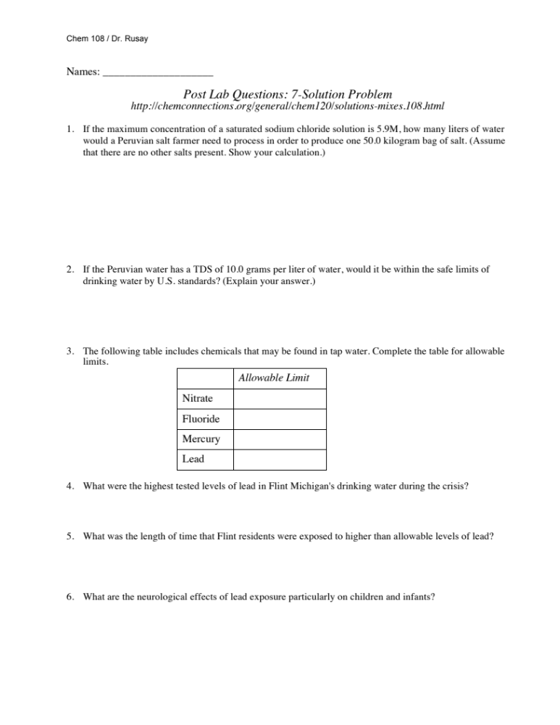
7 Solution Problem
Due Today
Individually completed Report Form pp. 76-80;
Aqueous Reactions including
Net Ionic Equations
&
Post Lab Questions Form

Slide 3
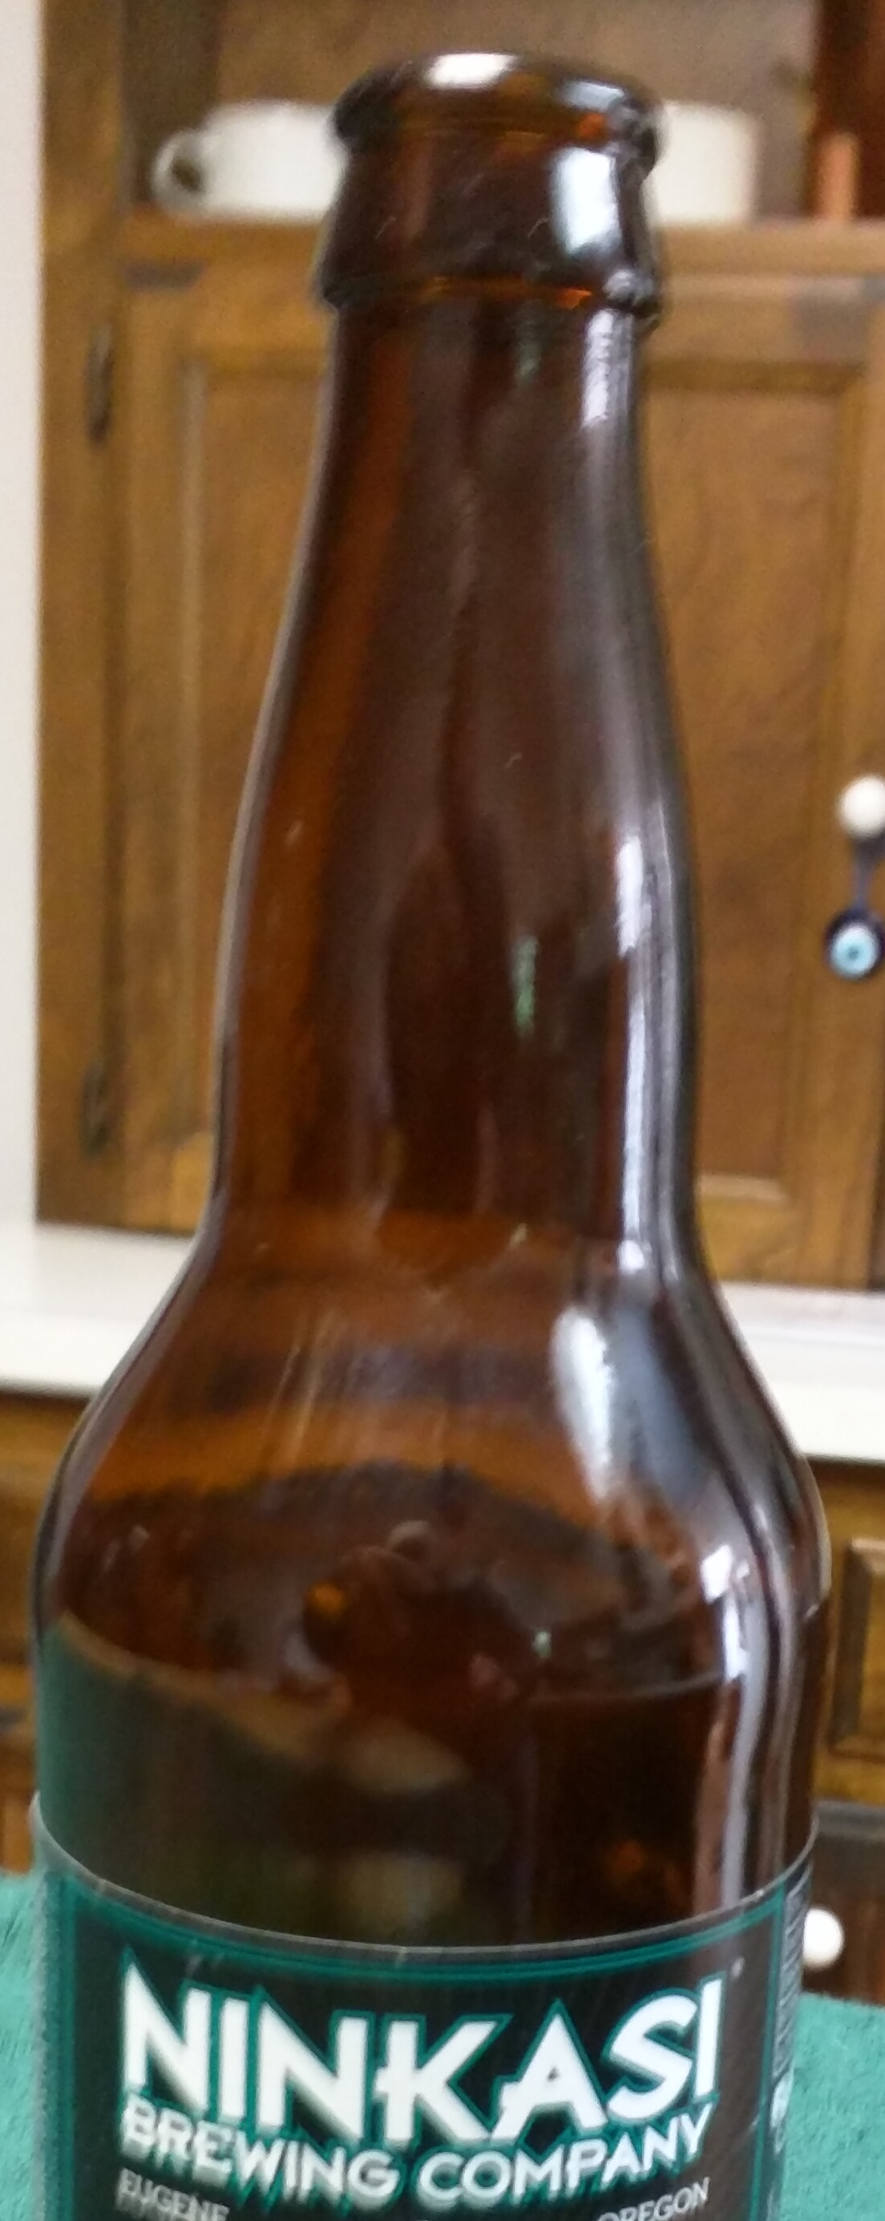
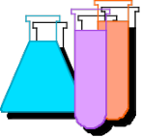
Chemical Reactions
To DO Today
Separating the Ethanol Produced
  Fermentation / Distillation pp.63-67
_________________________
http://www.piney.com/BabNinkasi.html)
Notes:
A 3900-year-old clay tablet, which was found in Iraq between the Tigris and Euphrates rivers, had a Sumerian poem (http://www.piney.com/BabNinkasi.html) honoring Ninkasi, the patron goddess of brewing. It contains the oldest surviving beer recipe, describing the fermentation of the carbohydrates found in bread, bappir, made from barley, honey, dates and sweet aromatic herbs. The global availability of carbohydrates and native microbes (yeasts) has led to the production of many different types of beers, ales, wines, and fruit based alcoholic beverages in many countries throughout the world. [The bottle on the left was found in Eugene, Oregon, ……. But, it dates only to 2016.]

Slide 4
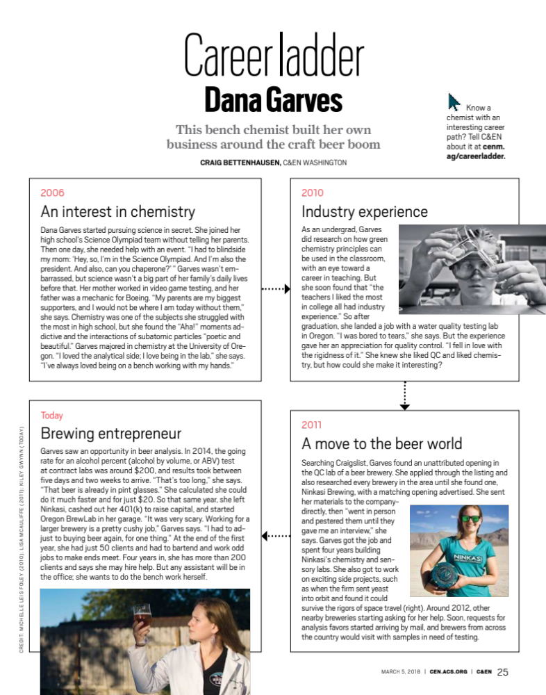
http://chemconnections.org/general/chem108/Beer-Ninkasi-Dana%20Garves.pdf
Biological Reactions: Enzyme Catalysts
  Fermentation / Distillation
Notes:
A 3900-year-old clay tablet, which was found in Iraq between the Tigris and Euphrates rivers, had a Sumerian poem (http://www.piney.com/BabNinkasi.html) honoring Ninkasi, the patron goddess of brewing. It contains the oldest surviving beer recipe, describing the fermentation of the carbohydrates found in bread, bappir, made from barley, honey, dates and sweet aromatic herbs. The global availability of carbohydrates and native microbes (yeasts) has led to the production of many different types of beers, ales, wines, and fruit based alcoholic beverages in many countries throughout the world. [The bottle on the left was found in Eugene, Oregon, ……. But, it dates only to 2016.]

Slide 5
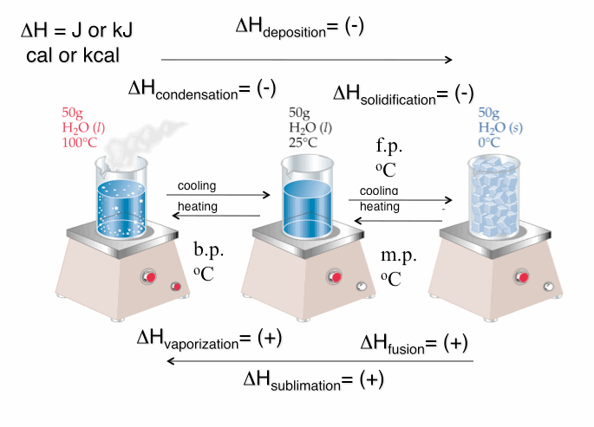
Energy: Heat: Enthalpy (ΔH)

Slide 6
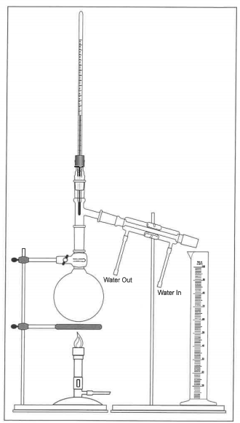
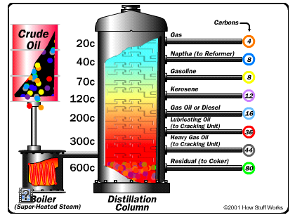
Distillation
http://chemconnections.org/general/movies/html-swf/oil-refining.swf
Oil Refining:
http://science.howstuffworks.com/oil-refining4.htm

Slide 7
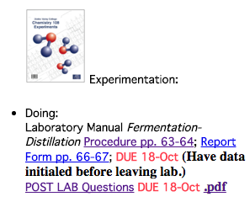
Distillation
Doing:
Laboratory Manual Fermentation-Distillation Procedure pp. 63-64;

Slide 8
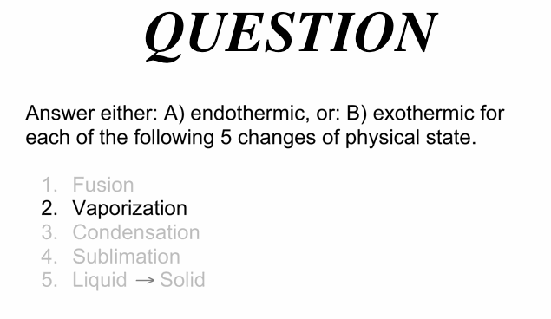
A) endothermic

Slide 9
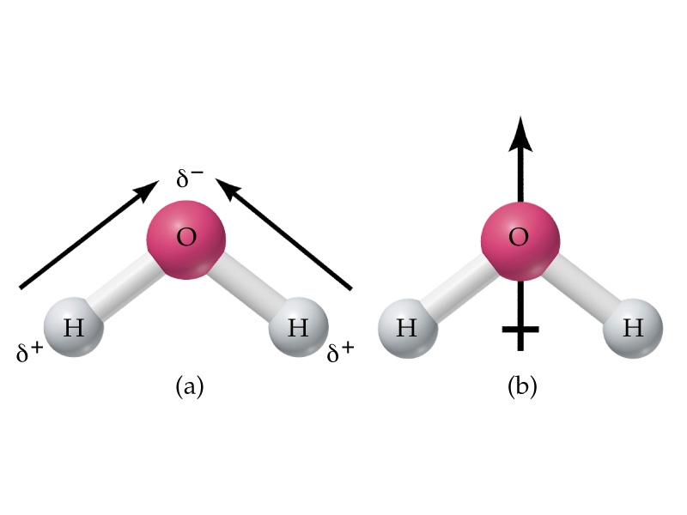
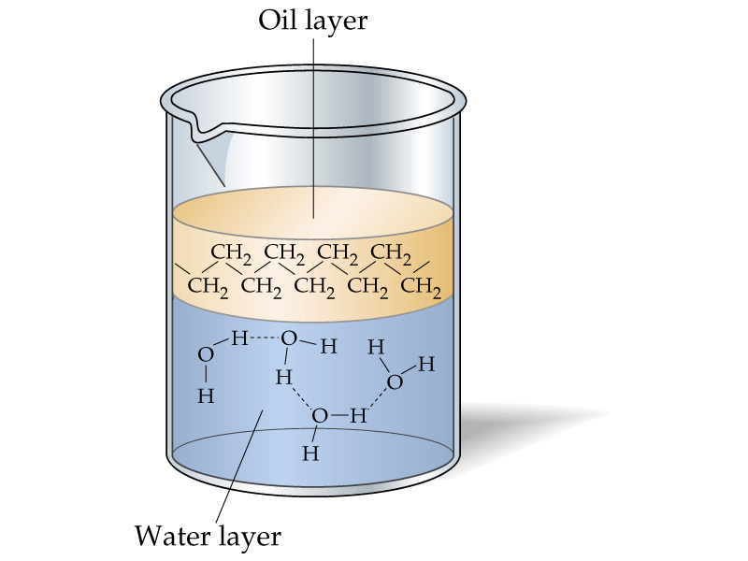
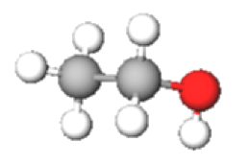
Water : “The Universal” Solvent
The ethanol product is miscible in water and both vaporize when the solution is distilled.

Slide 10
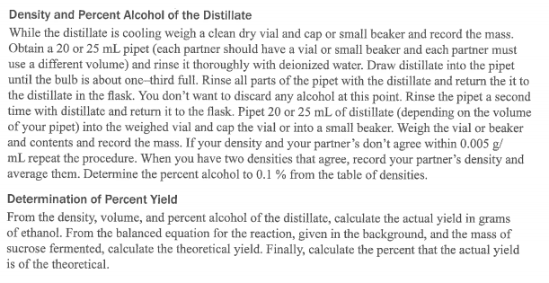

Theoretical & Percent Yield
http://chemconnections.org/general/movies/html-swf/oil-refining.swf
The ethanol produced in the fermentation is distilled along with the water used. The liquid collected is ethanol mixed in with the water, which is the solvent. The amount dissolved will be calculated by experimentally determining the solution’s density.
What is a solution’s concentration?

Slide 11
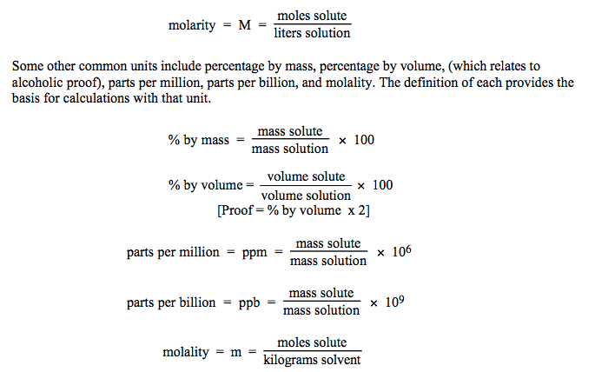
Solution Concentrations
Concentration is a measure of the amount of solute dissolved.

Slide 12
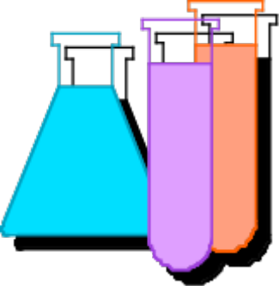
Solution Concentrations
Molarity (M) = moles solute / Liter_{solution}
mol = (mol solute / Liter_{solution}) x Liter_{solution}
An important relationship is M x V_{solution}= mol
It is used directly in mass calculations of chemical reactions and in the dilutions of solutions.

Slide 13
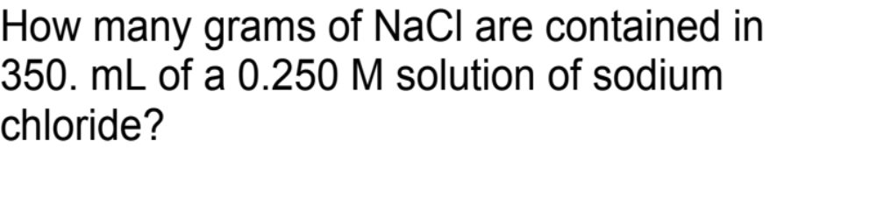
Seven Solutions Post Lab Question
http://chemconnections.org/general/chem120/solutions-mixes.108.html
Solutions: molarity & volume → mass
Volume
(L) times concentration
(mol/L) gives
moles. M x V_{solution}= mol
Moles are then converted to grams multiplying by the molar mass.
0.250 M = 0.250 mol/L; Molar Mass NaCl = 58.4 g/mol
350.mL x 1 L/1000 mL x 0.250 mol/L x 58.4 g / mol =
5.11 g

Slide 14
Seven Solutions Post Lab Question
http://chemconnections.org/general/chem120/solutions-mixes.108.html
Solutions: molarity & volume → mass
If the maximum concentration of a saturated sodium chloride solution is 5.9M, how many liters of water
would a Peruvian salt farmer need to process in order to produce one 50.0 kilogram bag of salt.
5.9 M = 5.9 mol/L; Molar Mass NaCl = 58.4 g/mol
? L x 5.9 mol/L x 58.4 g / mol = 50.0 kg _{NaCl}

Slide 15
7 Solutions Report pp. 76-80
& Post Lab Questions
Due Today

Slide 16
Solution Concentrations
Concentration in mass percent is common.
Mass % = Mass solute / [Mass solute + Mass solvent ] x100
What is the mass % of 65.0 g of glucose dissolved in 135 g of water?
Mass % = 65.0 g / [65.0 + 135]g x 100
= 32.5 %

Slide 17
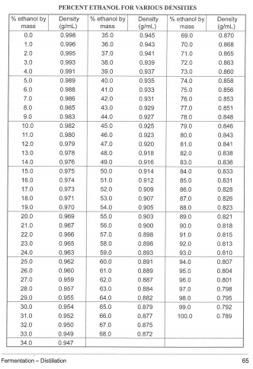
% Ethanol from Density

Slide 18
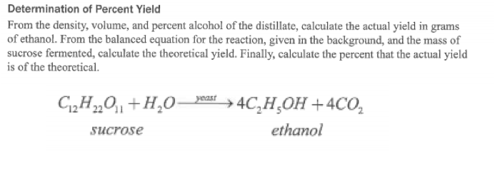

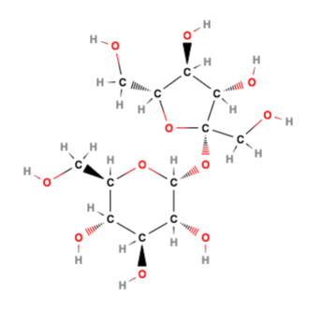
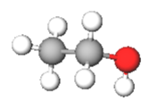
Calculations

Slide 19
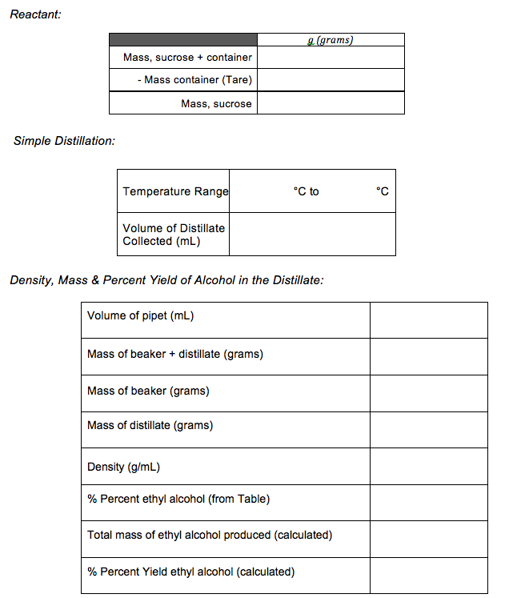
Example
24.55 g
52.2 mL
9.90 g/ 10.00mL
0.990 g/mL

Slide 20
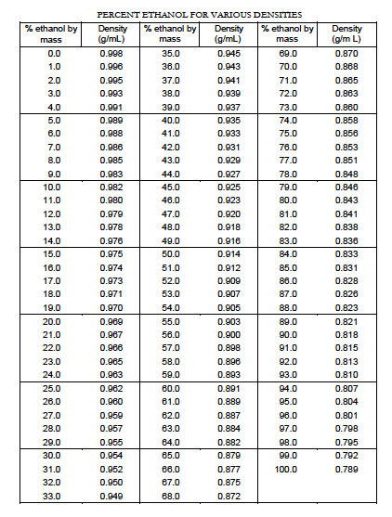
Example
24.55 g
4.5 %
52.2 mL
0.990 g/mL

Slide 21
Theoretical Yield Calculation
24.55 g
? g (theoretical)
4
Molar mass = 342.3 g/mol
Molar mass = 46.07 g/mol
? mol sucrose = 24.55 g / 342.3 g/mol
= 0.07172 mol
? mol C₂H₅OH = 4 x mol sucrose
= 0.2869 mol
? g (theoretical) = mol C₂H₅OH x 46.07 g/mol
= 13.22 g
__________________
? g (actual) = [4.5 % ,that is: 4.5/100] x 52.2 mL x 0.990 g/mL
= 2.33g
% Yield = g (actual) / g (theoretical) x 100
= 17.6 %

Slide 22
Theoretical & Percent Yield
Doing:
Complete Distillation Procedure pp. 63-64; Report Form pp. 66-67; DUE: Next Week (Show Dr. R. distillate before disposing down the drain & have data initialed before leaving lab today.)
POST LAB Questions DUE: Next Week Pick up Handout

Slide 23
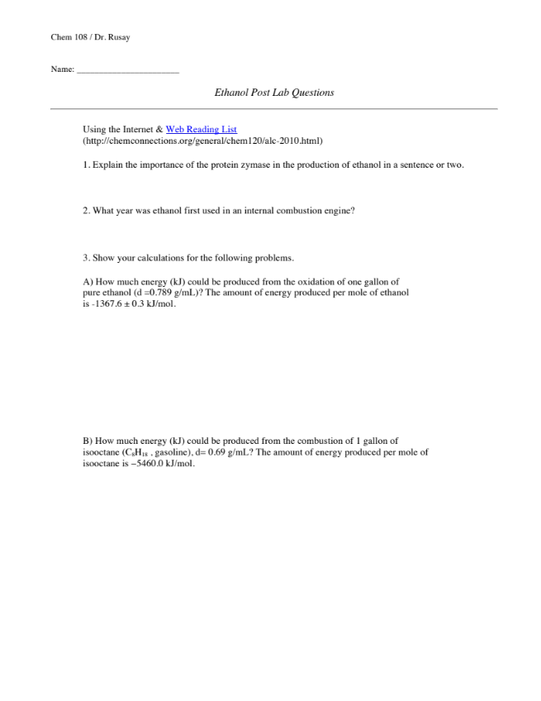
POST LAB Questions; Handout
Turn in Next Week
http://chemconnections.org/general/chem120/ethanol-ques-108.htm

Slide 24
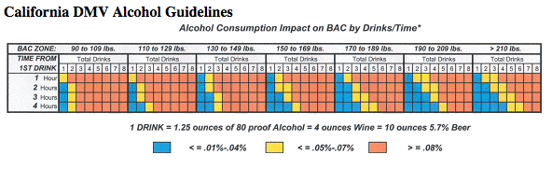
POST LAB Questions DUE: Next Week
http://chemconnections.org/general/chem120/ethanol-ques-108.htm
https://www.youtube.com/watch?v=P--6LEbksds

Slide 25
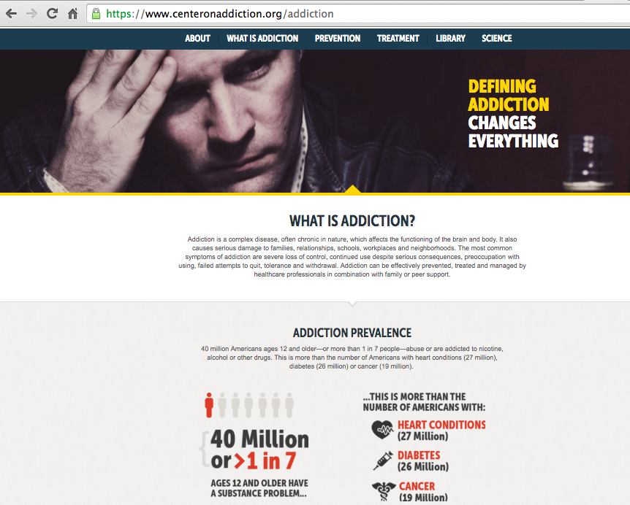
https://www.centeronaddiction.org/

Slide 26
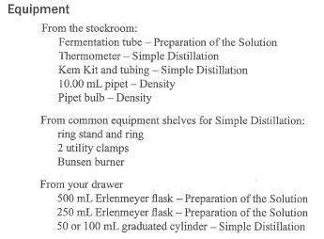
Distillation

